Slide 1
Plotting System and CRT Display
Mioara Joldes
Pasca Bogdan

Slide 2
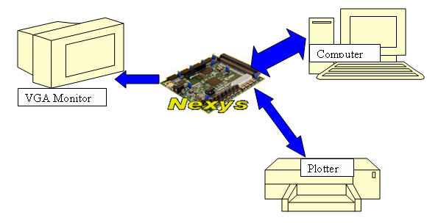
How does it look like?

Slide 3
What is a Plotter?
A printing device
It uses ink pens or pencils.
Draws images as a series of lines.
    This case: HOME MADE PLOTTER

Slide 4
How to built it?
HARDWARE DESIGN
  Actually building it
SOFTWARE DESIGN
  Programming and Controlling

Slide 5
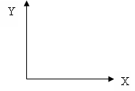
Hardware design
Create two movement axes for pen position
Use two DC motors to control this movement
- provided by Digilent
- have 2 Hall sensors
The surface to be drawn is fixed
  It offers the possibility to use rigid, inflexible surfaces

Slide 6
Hardware Design
Has two positions for pen’s head:
  Up
  Down
Control them using a Servo motor
  provided by Digilent

Slide 7
Hardware Design
Built the frame and the rest of the machinery
  Two broken printers used
  Wooden support for drawing surface
  Everything assembled in a workshop

Slide 8
Hardware design
Controlling DC motors
Control the 2 DC Motors by connecting them to HBridge modules
Power the HBridge module with 5V (the specific voltage for the DC motor)
Connect the HBridge to the Nexys Board

Slide 9
Hardware Design
Controlling DC motors
The DC motors can be controlled by sending logical signals, like direction and enable to the HBridge
Hbridge transforms the logical signals into appropriate signals for the motor taking into account the motor voltage that the Hbridge is suplied with

Slide 10
Hardware Design
Controlling DC motors
Hbridge also transforms the Hall signals received from the motor into logical signals
Spinning velocity depends on the fn (power or enable) signal that Nexys provides to the motor

Slide 11
Hardware Design
Controlling DC motors
Control the velocity by increasing or decreasing the filling factor on the 10 ms period signal fn provided to the motor.
A filling factor of 1 gives the maximum velocity

Slide 12
Hardware Design
Speed issues
We have to find an equilibrium between the printing speed and the printing quality.
At high speeds, vibrations occur
Had to triangulate the horizontal axis to reduce vibrations

Slide 13
Hardware Design
Controlling servo motor
Servo motor has 3 lines:
      VCC line
      Ground
      Control
It can rotate it’s shaft to about 180 degrees

Slide 14
Hardware Design
Controlling servo motor
How to control the angular motion?
Send pulses on the control line at a period of 20 ms
The length of the pulse determines the new alignment of the shaft

Slide 15
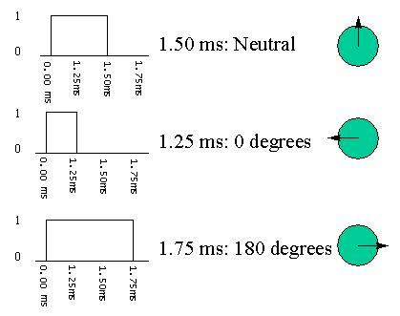
Hardware Design
Controlling servo motor
Usually the pulse lengths are:

Slide 16
Hardware Design
Adding Sensors
Have to initialize the plotter before starting the print process
Put sensors at the end of both X and Y axes
These are triggered when the printing head is in the initial position

Slide 17
Hardware Design
Adding Sensors
When the trigger is closed, the out line will go to ground – ‘0’ logic
When the trigger is open the out line is in ’1’ logic
vcc
trigger
out

Slide 18
Hardware Design
VGA module
In order to display the image on a computer monitor, a link between the Nexys board and the monitor is needed
The VGA module
It is firmly inserted into it’s specific location on the Nexys board

Slide 19
Hardware Design
VGA module
Supports 3 bits of color for each color channel, along with the horizontal and vertical synchronization
It is able to distinguish between 512 colors

Slide 20
Hardware Design
Connection with computer
Connection is done trough the mini USB 2 controller found on the Nexys board
The images are sent to this controller by the TransPort application found in the Adept Suite

Slide 21
What is to be drawn?
Bmp image
640 X 480 pixels
Monochrome
Sent to the board using Adept Suite (TransPort)

Slide 22
Software design
Software used :
  Xilinx ISE 8.1i
  ModelSim XE III 6.0a for simulation
  VHDL

Slide 23
How does it looks like?

Slide 24
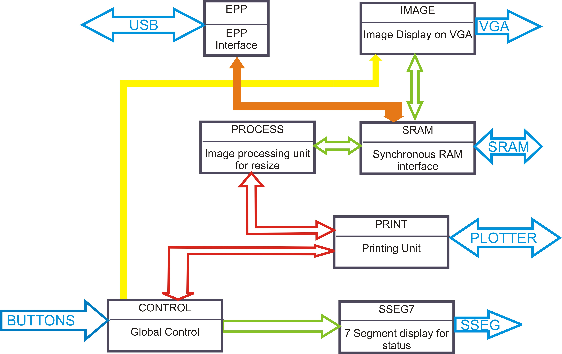
Top Level Schematic

Slide 25
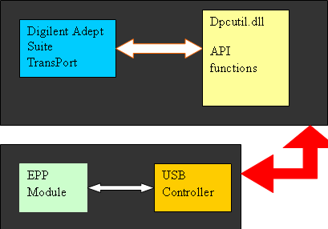
Components used
EPP Interface

Slide 26
Components used
VGA Display
the display is done on the CRT monitor at a resolution of
640 x 480 pixels, 60Hz
Horizontal and vertical synchronization counters used
Pretty complex memory address to compute
Purpose : see what image is to be drawn

Slide 27


VGA Display
Tricky part
pixels displayed on the screen
pixels stored in .bmp-file
How to compute memory address?

Slide 28
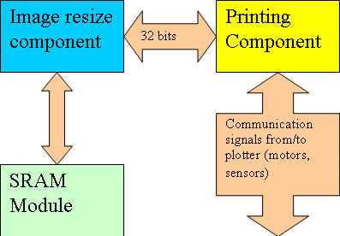
Components Used
Printing Component
Major importance for the design
Communicates with the plotter hardware and with the Image resize Component

Slide 29
Components Used
Printing Component
Has a buffer of 32 bits which is filled periodically on request
The coordinates of current pen position are also sent

Slide 30
Components Used
Printing Component
Does not have direct access to memory.
Feature: Is not connected to a fixed place for taking the data to be printed.
Can be used to print anything else as long as the buffer is filled on request

Slide 31
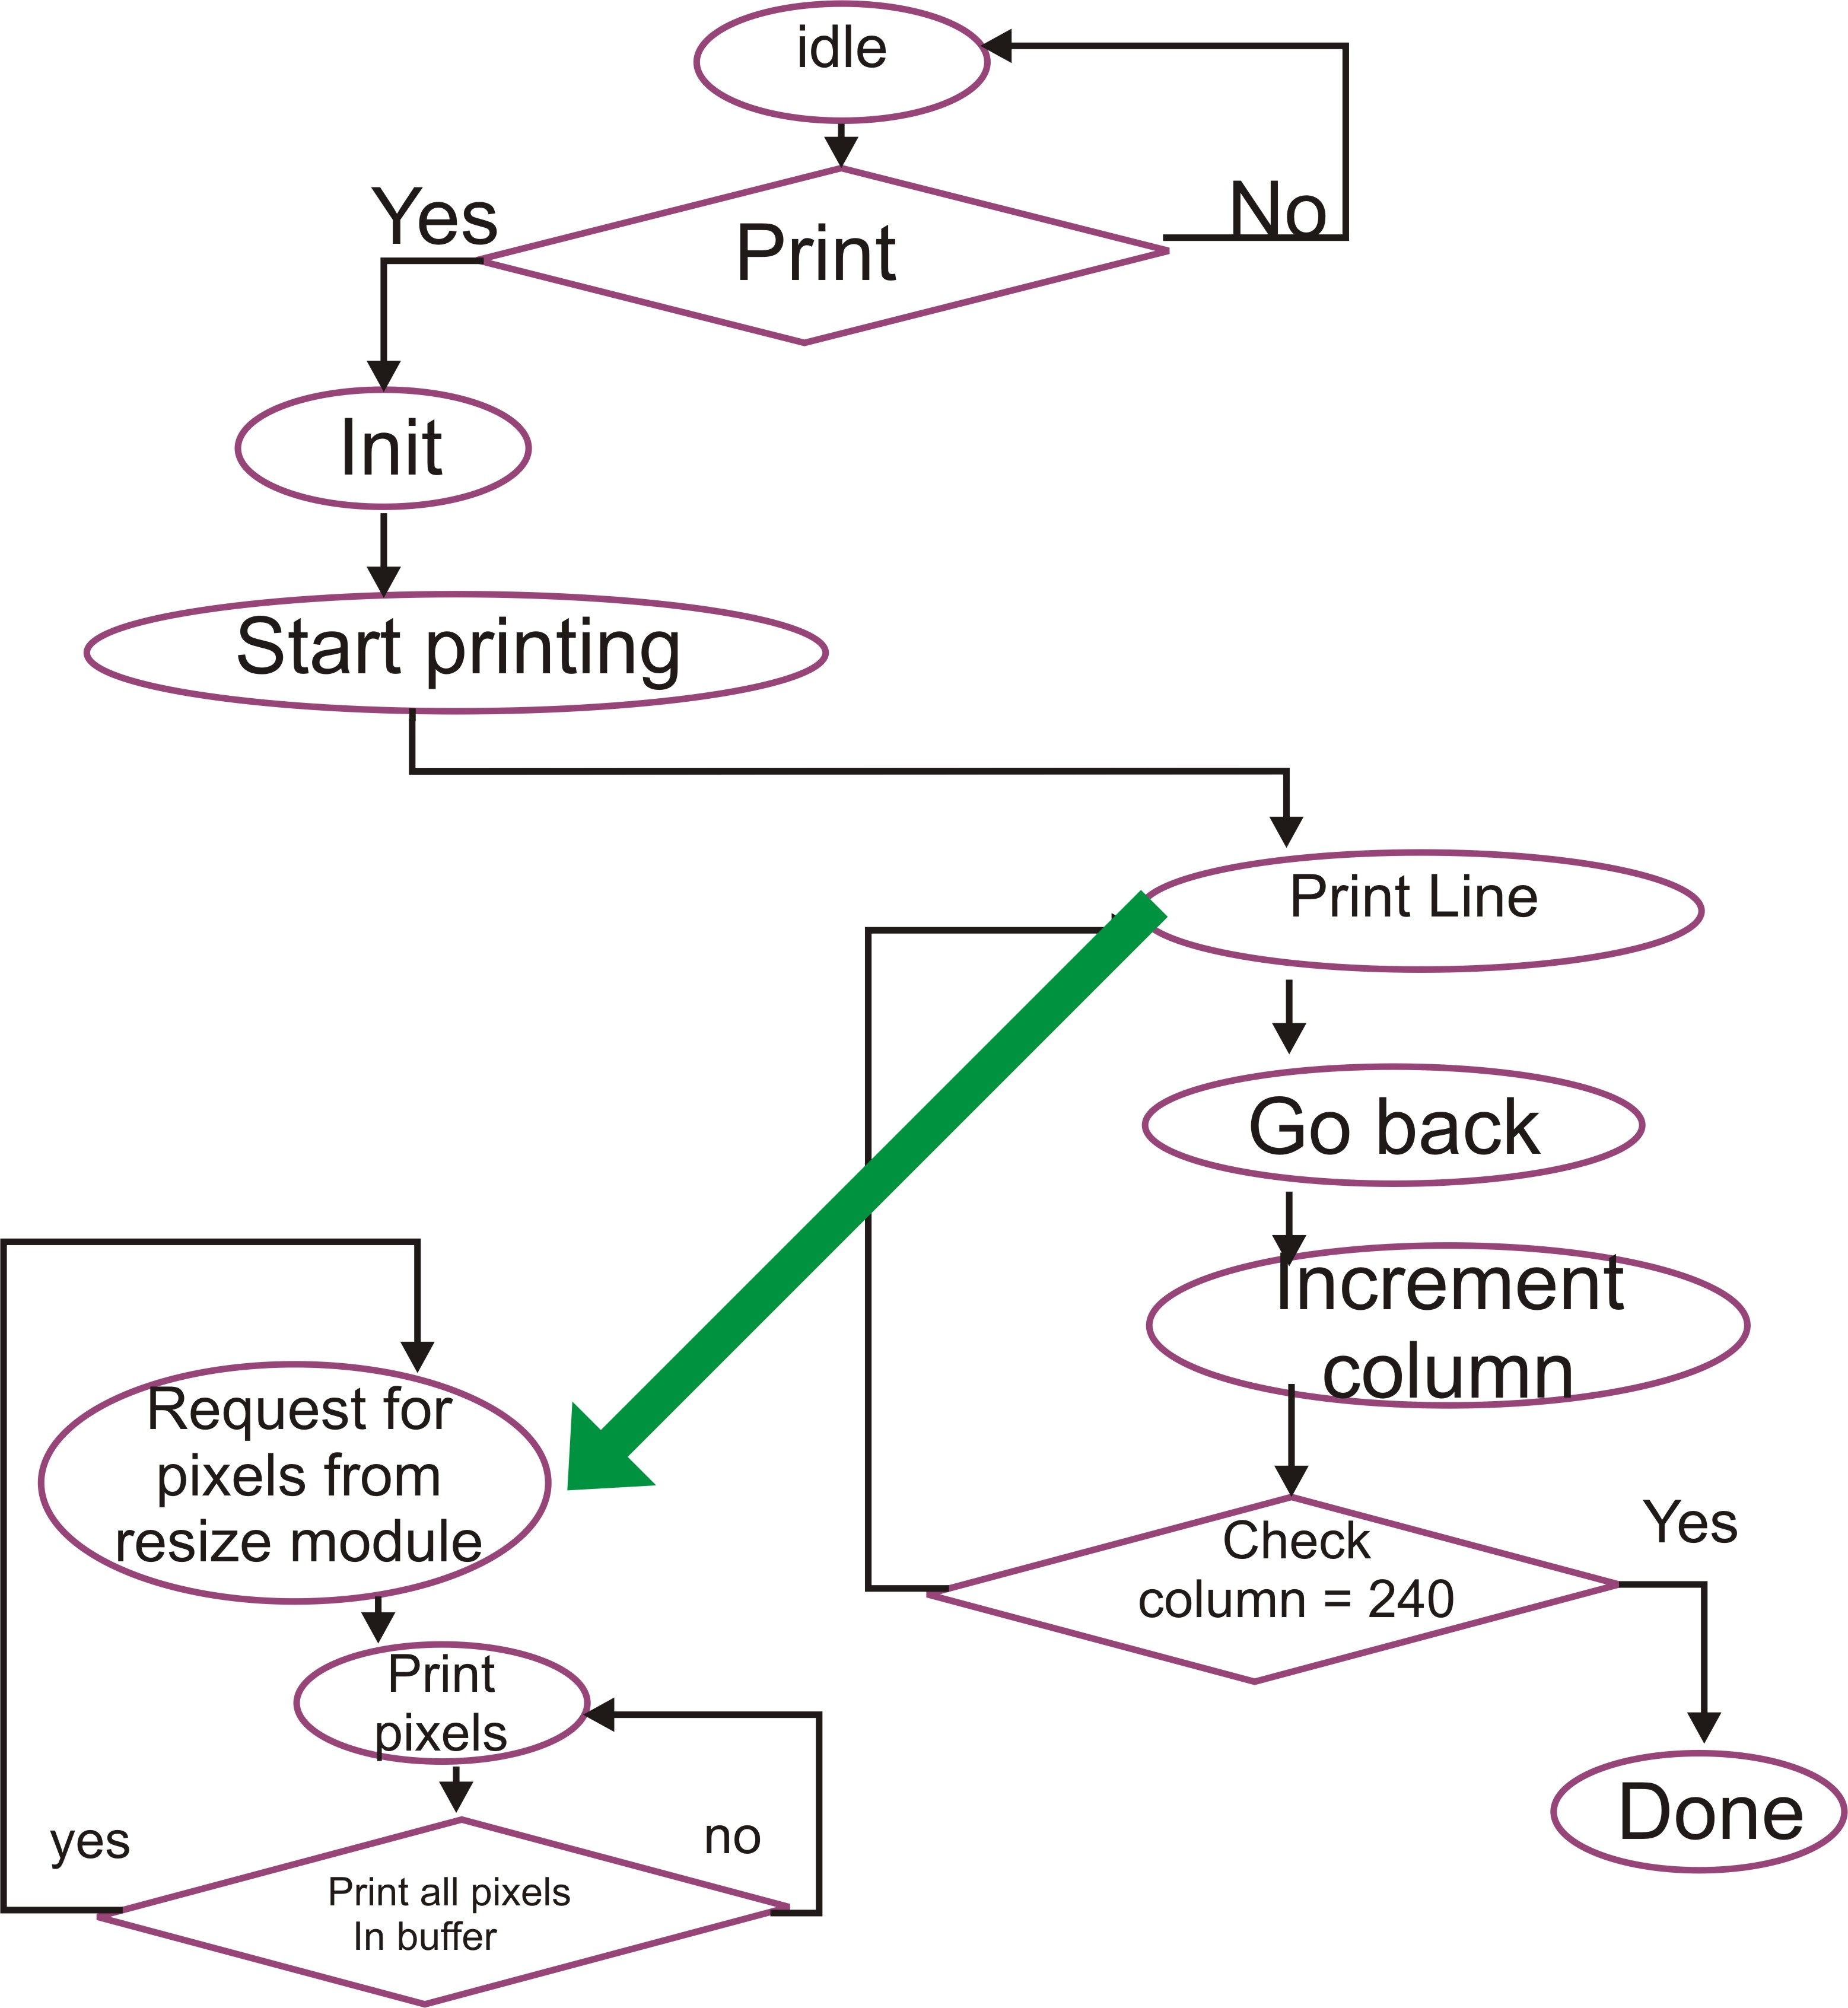
Components Used
Printing Component
FSM implementation

Slide 32
Components Used
Printing Component
Optimization:
  A displacement on a line is NOT taken unless the line is not EMPTY
  Increases considerably the speed

Slide 33
Components Used
Image Resizing Component
Original image : 640 x480 pixels
Printing Resolution: 320x240 points
Resize filter used: from 4 adjacent pixels, obtain one new pixel

Slide 34
Components Used
Image Resizing Component
Sends on request 32 processed bits to the printing component
Processes 64 bits in real image
Implemented as a FSM
Has access to memory

Slide 35
Components Used
Control Component
  Through the usage of the pushbuttons one can control the printing and displaying process
Seven Segments component
  Used to display the state of the system

Slide 36
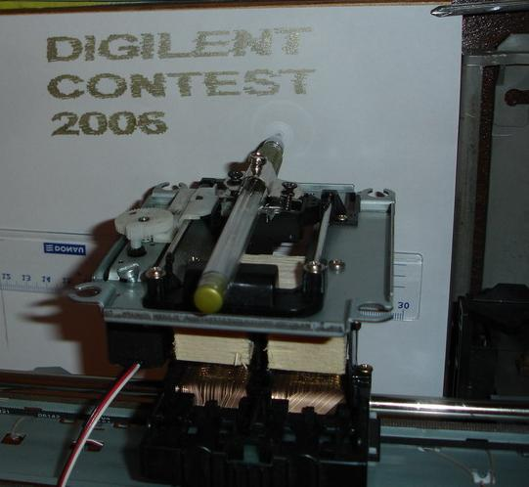
Practical results

Slide 37
Reusable components
The printing module
The VGA display can also be reused unchanged.
The EPP controller
The seven segment display can also be easily reused
The resize image unit can be reused for applying the same process to other resolutions

Slide 38
Conclusion
Why another plotter?
  challenge for many engineering students
  practical importance
  New way of using DC and Servo motors
  Reuse some mechanical parts of broken machines
  Draw on inflexible surfaces (not only paper)
Hand-made Plotter using FPGA design

Slide 39
Future development
New usage easy to obtain:
-Change the pen with a drill or cutter and get an engraver
Create a file format that stores an image in vector mode and draw it as a collection of lines with different slopes

Slide 40
References
Digilent Nexys Board Schematic Rev. F. http://www.digilentinc.com/Data/Products/NEXYS/Nexys_sch.pdf
Digilent Adept Users Manual
http://www.digilentinc.com/Data/Software/Adept/Adept%20Users%20Manual.pdf
Digilent Parallel Interface Model Reference Manual http://www.digilentinc.com/Data/VHDLSource/EPP_Parallel/DpimRef.pdf
VGA Timing Characteristics http://www.epanorama.net/documents/pc/vga_timing.html
DC Motor http://en.wikipedia.org/wiki/DC_motor#DC_motors

Slide 41
References
Whats a Servo? http://www.seattlerobotics.org/guide/servos.html
Bilinear Filters and Resizing http://www.codeproject.com/cs/media/imageprocessing4.asp

